Slide 1
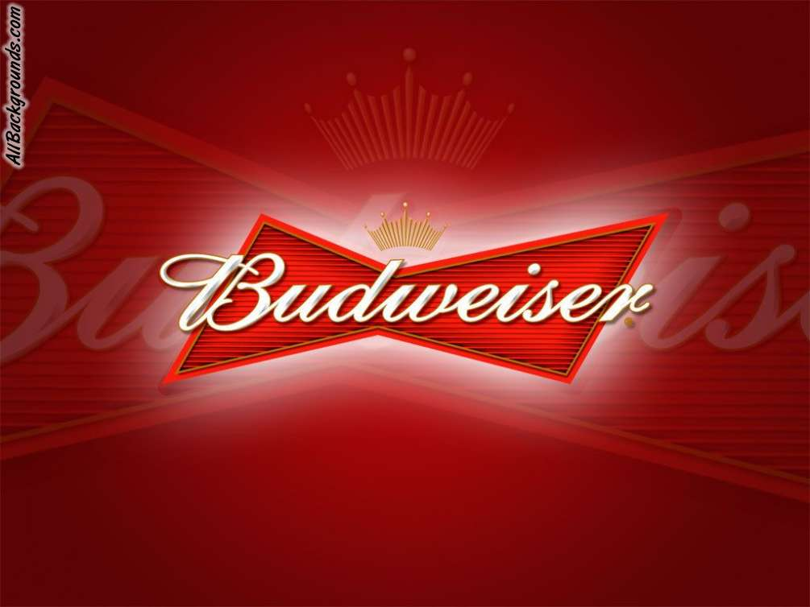
BREWERIES AND BEERS, a data analysis
Ana Alfaro
Alexander sepenu
Jake harrison

Slide 2
Demographic
Exploring States and Regions
Characteristics
Bitterness and Alcohol Content
Insights
Data Relationships

Slide 3
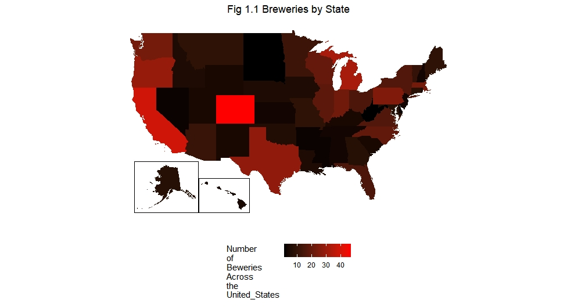
Breweries by State
MIN
MAX
State | Count
DC | 1
ND | 1
SD | 1
WV | 1
AR | 2
State | Count
TX | 28
OR | 29
MI | 32
CA | 39
CO | 47
Demographic
Characteristics
Insights

Slide 4
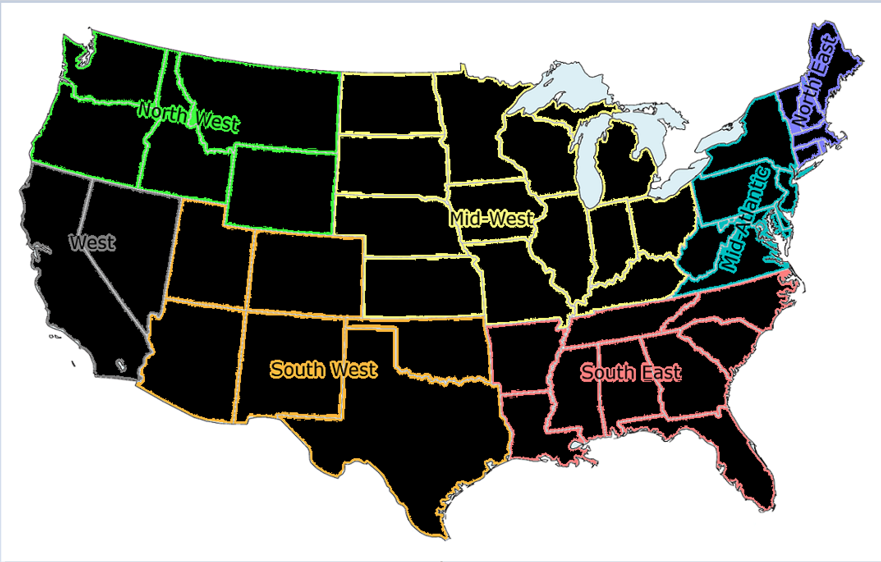
Regions
Demographic
Characteristics
Insights

Slide 5
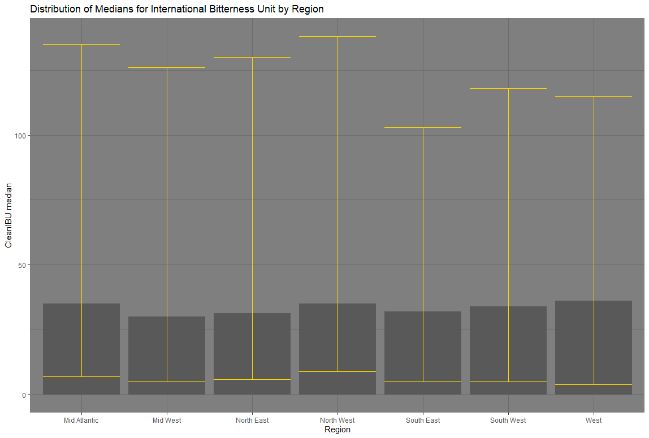
international bitterness unit of beers by region
Demographic
Characteristics
Insights

Slide 6
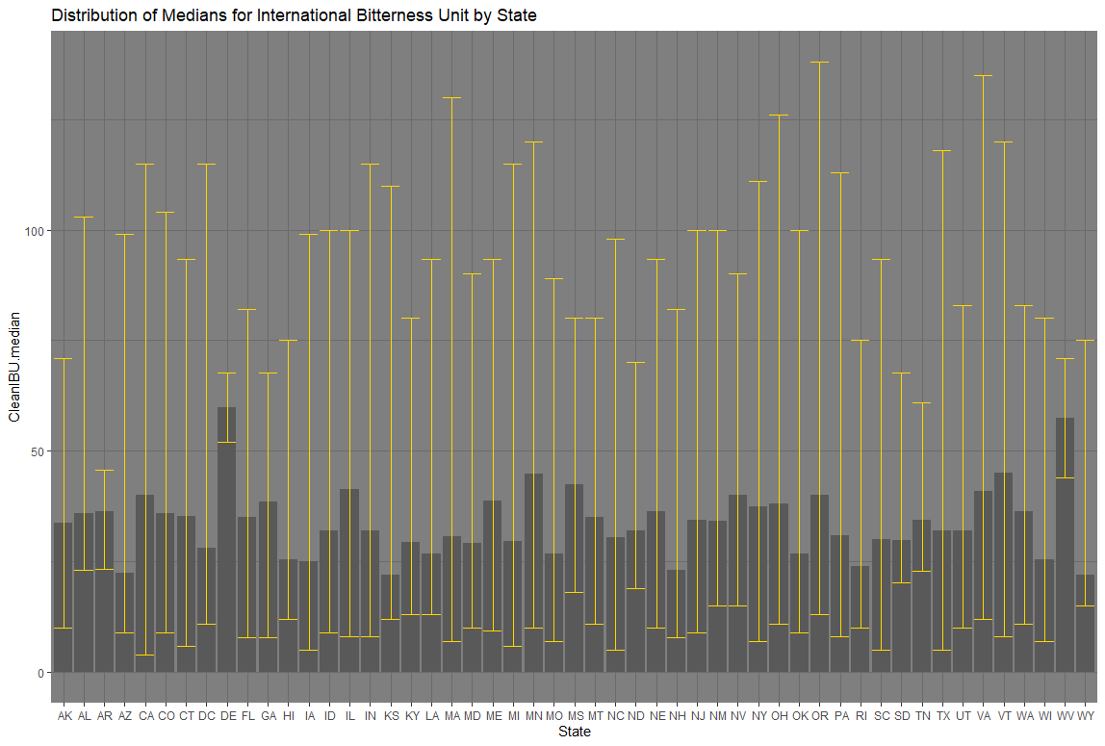
international bitterness unit of beers by state
MIN
MAX
State | Median
WI | 19
KS | 20
AZ | 20.5
WY | 21
HI | 22.5
MO | 24
RI | 24
State | Median
NH | 48.5
NM | 51
DE | 52
GA | 55
FL | 55
WV | 57.5
ME | 61
Demographic
Characteristics
Insights

Slide 7
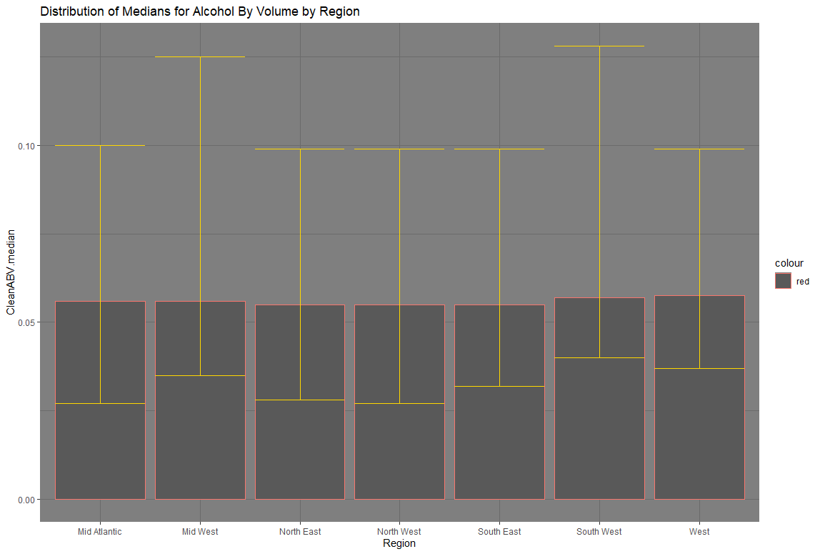
alcohol by volume of beers by region
Demographic
Characteristics
Insights

Slide 8
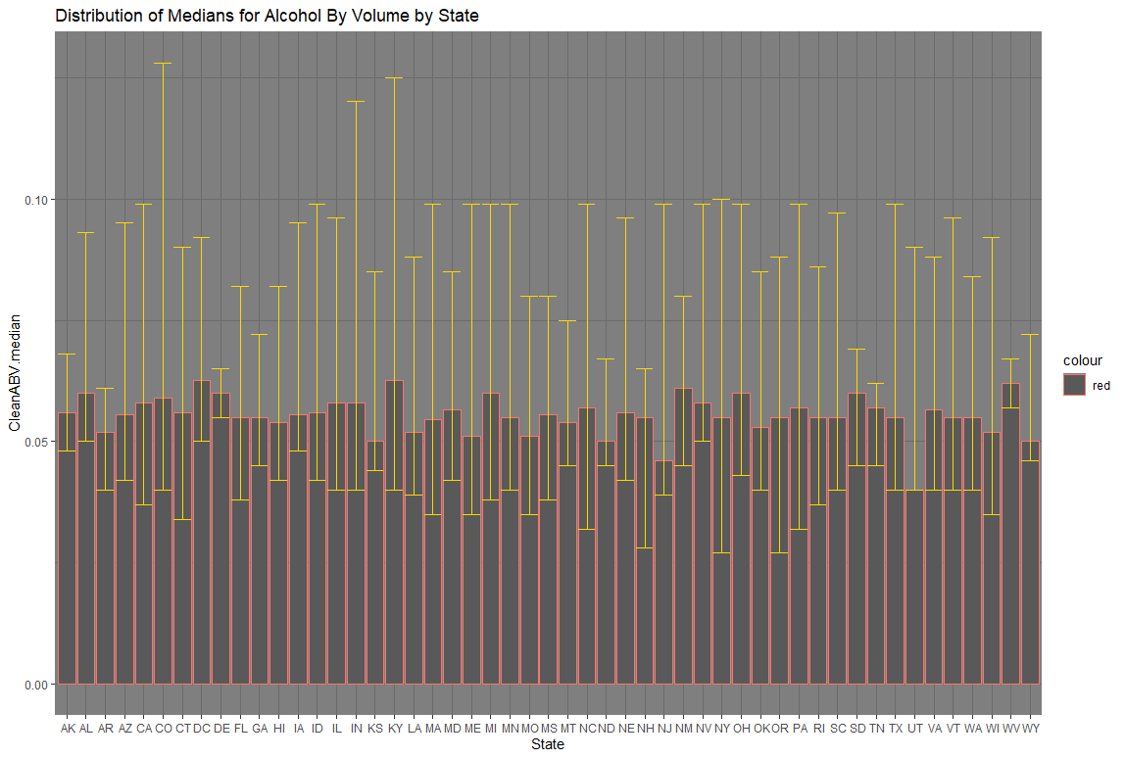
alcohol by volume of beers by STATE
MIN
MAX
State | Median
AR | 0.0400
UT | 0.0400
NJ | 0.0460
NH | 0.0465
KS | 0.0500
MO | 0.0500
ND | 0.0500
State | ABV
CT | 0.061
WV | 0.061
GA | 0.062
FL | 0.062
OK | 0.063
CO | 0.065
ME | 0.067
Demographic
Characteristics
Insights

Slide 9
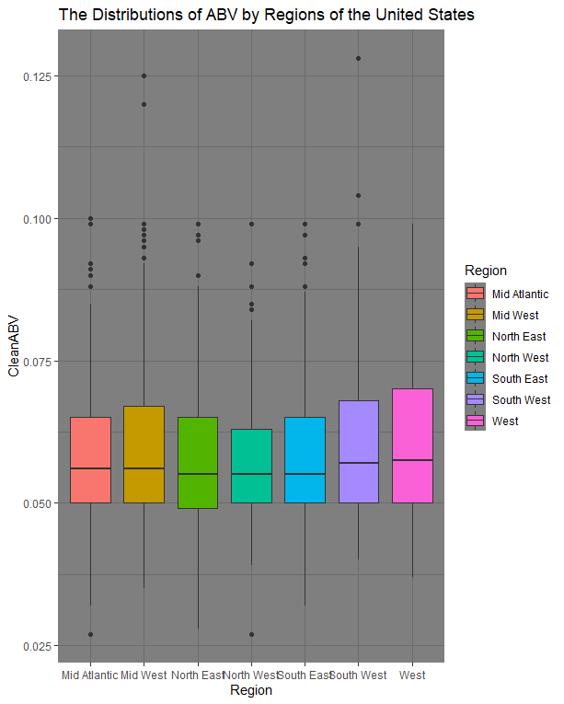
CHARACTERISTICS OF ALCOHOL VOLUME BY REGION
Demographic
Characteristics
Insights

Slide 10
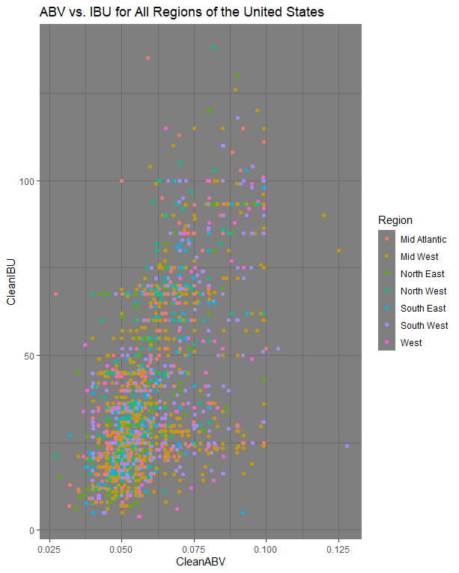
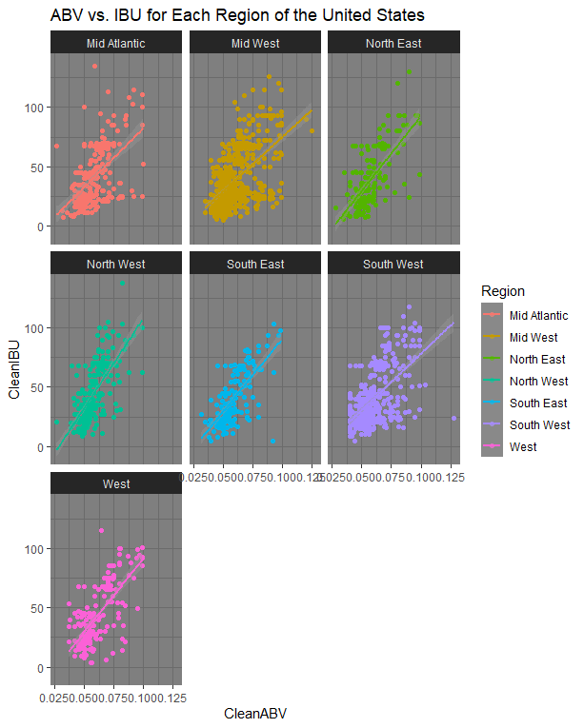
COMPARING ALCOHOL BY VOLUME AND BITTERNESS BY REGION
Demographic
Characteristics
Insights

Slide 11
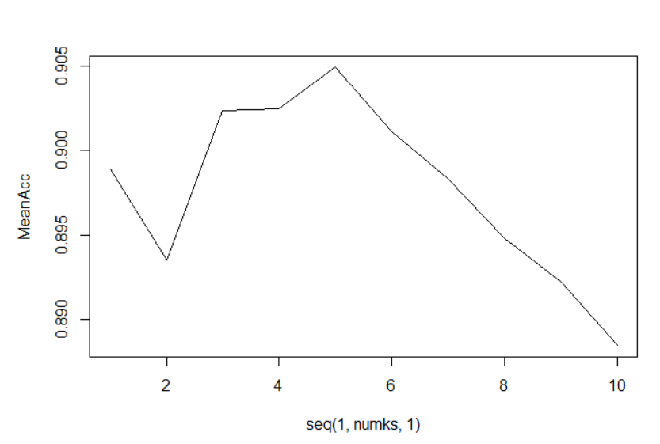
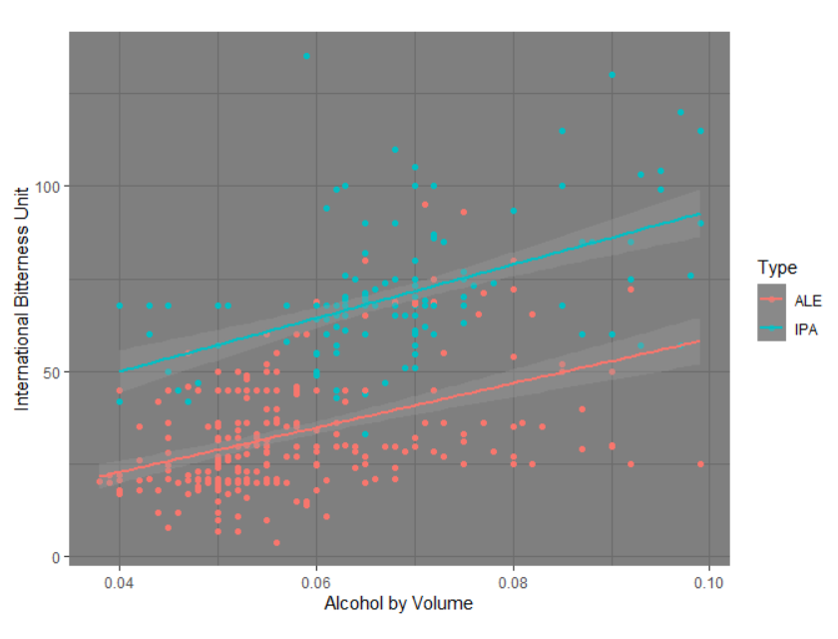
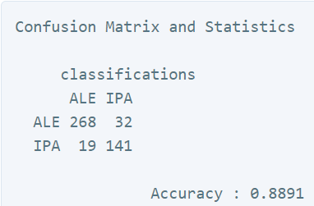
K-nearest neighbors’ predictions for ale and ipa
Demographic
Characteristics
Insights

Slide 12
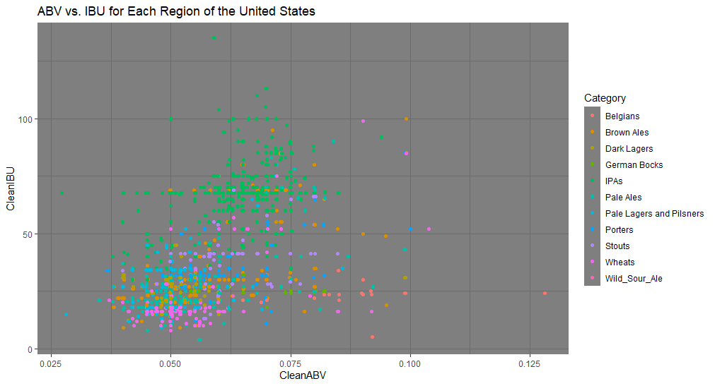
Comparing ibu and abv all styles of beer in each region
Demographic
Characteristics
Insights

Slide 13
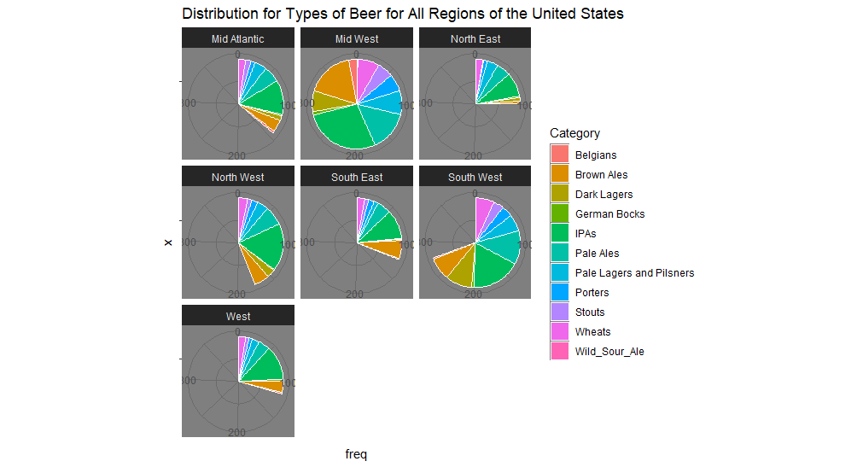
Distributions of styles of beers for all regions of the us
Demographic
Characteristics
Insights

Slide 14
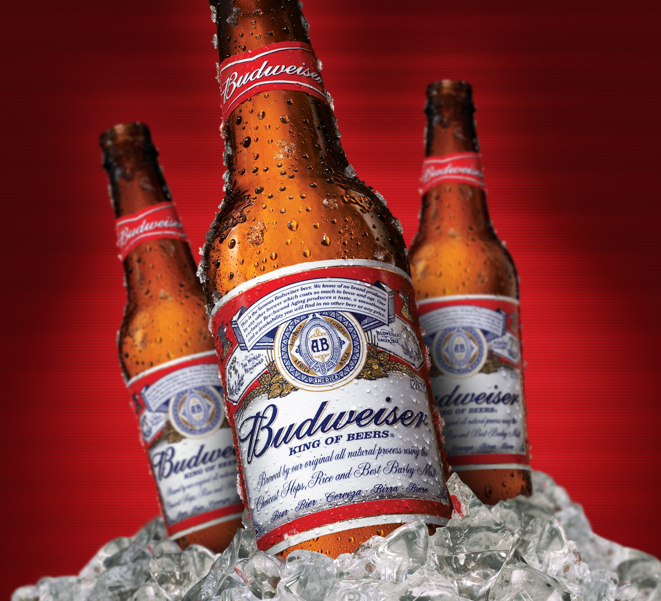
QUESTIONS and feedback

